Slide 1


COMP08035 Computer Games Design
Week 02 Lecture – The Game Development Lifecycle

Slide 2
Lecture Learning Outcomes
During this lecture you will learn the following:
Gain an overview of the games development life cycle (GDLC) and its importance in the context of games development.
Understand the benefits of agile development in the context of development methodologies with regards to games design.
Obtain a firm understanding of quality assurance (QA) and testing approaches in the area of games development.

Slide 3
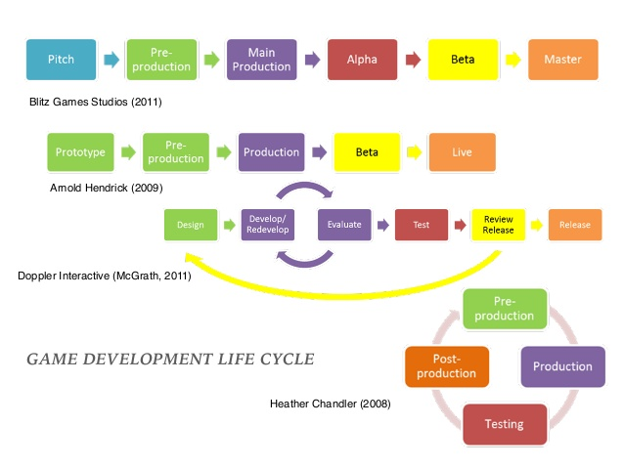
Game Development Life-cycle (GDLC)
Examples of Game Development Life Cycles:

Slide 4
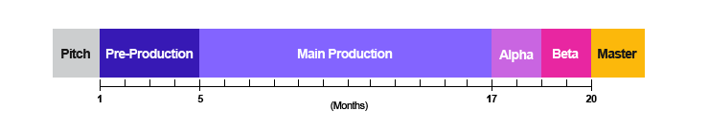
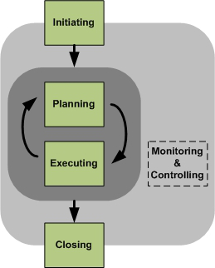
Game Development Life-cycle (GDLC)
Developing a game is a multidisciplinary complex process that distinguishes it from traditional software development (Aleem, Fernando Capretz and Ahmed, 2016, p.2).
Games are developed involving cross-functional teams.
Various approaches towards games design:
Blitz Games Studios (GDLC) – 6 phases
Arnold Hendrick’s – 5 phases

Slide 5
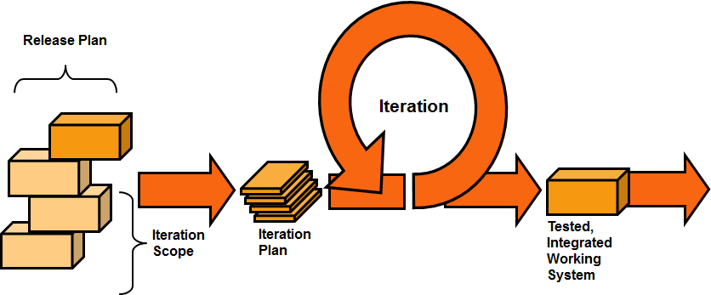
Game Development Life-cycle (GDLC)
Doppler Interactive GDLC (McGrath, 2011) adopts an iterative approach towards games development.
1) Design: relates to the creation of the initial design of the game and game design document;
2) Develop: develop a game engine for the game;
3) Evaluate: involves testing the game;
4) Redevelop: if the game does not meet requirements;
5) Test: if the game passes the evaluation (test game, engine, bug fixing);
6) Review release: game released to third party.
Repeat whole process from 1) to 6) until game ready for actual release.

Slide 6
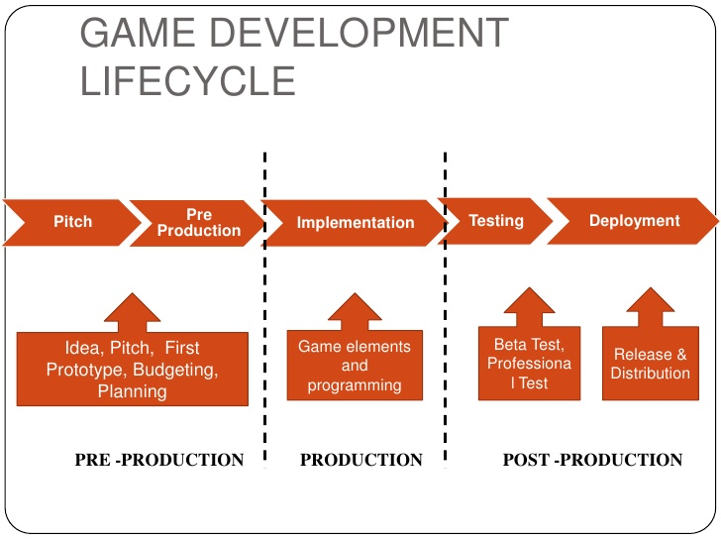
Game Development Life-cycle (GDLC)
The production cycle (Chandler, 2008): pre-production; production; test and post-production.

Slide 7
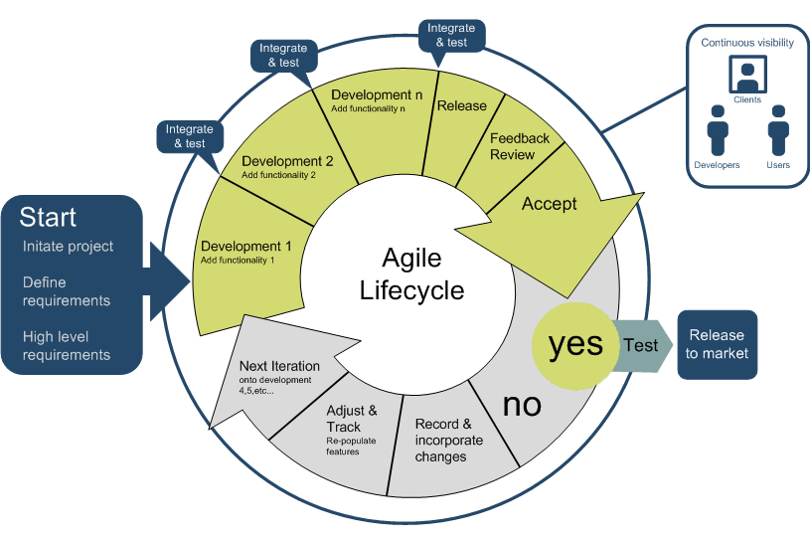
Agile Software Development
What is Agile? – “Agile is a set of methods and methodologies that help your team to think more effectively, work more efficiently, and make better decisions” (Stellman and Greene, 2015, p. 2).
Agile methodology focuses on: “… small interdisciplinary teamwork, communication and input from stakeholders, and ongoing implementation and iteration” (Fullerton, 2014, p. 421).

Slide 8
Main Elements of Agile Methodology
Flexible goals: involves planning around flexible goals, planning for changes and adapting to new ideas/information throughout stages of development.
Prioritised backlog: agile teams work with a backlog – a list of features sorted by priority. Teams will revisit backlogs and reprioritise features.
Sprints: agile developers work in a series of “sprints”. Each sprint is a few weeks long with a working deliverable at the end of it.
Scrum meetings: short meetings lasting 10-15 minutes; held standing up; each member discusses three things; solutions to problems discussed by team members after the meeting.
Demo day: after each sprint views and experiments with what was produced; risk analysis conducted and planning of next sprint.
Retrospectives: held at the end of each sprint, reflections about the process being used; adjustments required for next sprint.

Slide 9
Agile Manifesto
Creation of the Agile Manifesto in 2001 follows 12 principles to aid in the development of creating robust software.
satisfy customer through continuous delivery of valuable software;
harnessing change for customer’s competitive advantage;
deliver working software frequently;
working together daily with business people and developers;
building projects around motivated individuals;
conveying information to teams via face-to-face conversation;
Working software is the main measure of progress;

Slide 10
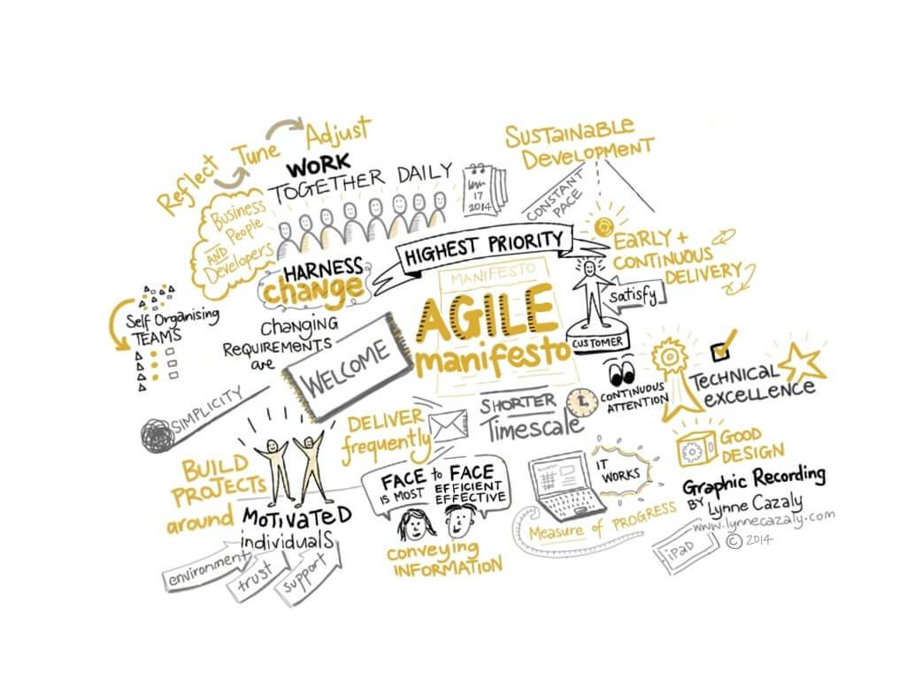
Agile Manifesto
Principles of the Agile Manifesto continued:
agile processes promote sustainable development;
technical excellence and good design enhances agility;
simplicity is essential;
architectures, requirements, and designs come via self-organising teams;
team reflects on how to become more effective.

Slide 11

Quality Assurance (QA)
QA testing known as “quality assurance”.
This testing does not relate to how enjoyable the game is but looking for bugs.
The main elements of Quality Assurance (QA) testing are (Gibson, 2015, p.152):
Find a bug in the game;
Discover and write down the steps required to reproduce the bug;
Prioritise the bug. Does it crash the game? How likely is it to occur for a normal player? How noticeable is it?
Inform engineering team so they can fix it.

Slide 12
Quality Assurance (QA)
QA testing involves the following stages (Fullerton, 2014, p.418, p.421)
QA team creates a test plan;
QA engineers run tests against current build;
Bugs then entered into database;
Bugs are assigned to specific individuals;
Fixed bugs are sent back to the QA team for retesting;
QA team satisfied bug fixed it is marked “resolved” in database.
Typical console title will have several thousand bugs in database;
Programmers work through database systematically;
Highest priority bugs eliminated first;
No more “priority 1” bugs in database = project is a beta;
Final stage of project = “gold code” = all bugs resolved.

Slide 13
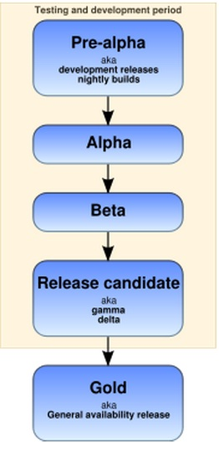
Game Testing
Two main aims of game testing (Schutz and Bryant, 2017, p.21):
Find defects that are in the game code or design;
Demonstrate which parts of the game are working properly.
Test Phases

Slide 14
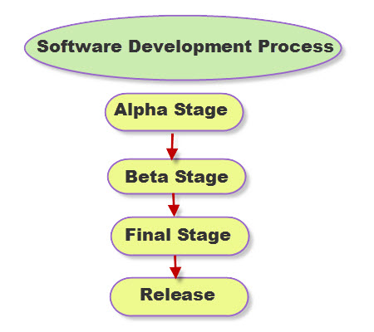
Test Phases: Alpha Testing
The main purposes of Alpha Testing (Schultz and Bryant, 2017, pp. 108-109):
Testing conducted in-house;
Performed by employees making the software;
Game design is fine tuned;
Features play tested, revised or removed;
Missing assets are integrated;
Systems created by different programmers are linked together;
Code and art teams check new work into build (check for defects);
All modules of game tested at least once;
Performance baselines established (frame rate, load times).

Slide 15
Test Phases: Beta Testing
Criteria typical of Beta Testing for a console game (Schultz and Bryant, 2017, pp. 110-113):
All features and options are implemented;
Code passes at least 100% of platform TRC (Technical Requirements Checklist);
Game can be navigated on all paths;
Entire graphical user interface (GUI) is final;
Game is compatible with all specified hardware and software configurations;
Game logic and AI is final;
All controllers work;
Final artwork is implemented;
Final audio is implemented;
All online modes are complete and testable;
All language version text is implemented and ready for simultaneous release.

Slide 16

Test Phases: Gold Testing
Criteria typical of Gold Testing (release testing) for a console game (Schultz and Bryant, 2017, pp. 113-114):
All known Severity 1 bugs (crashes, hangs, major function failures) are fixed;
Greater than 90% of all known Severity 2 bugs are fixed;
Greater than 85% of all known Severity 3 bugs are fixed;
Known open issues have a workaround that has been communicated to technical support;
Release-level performance has been achieved.

Slide 17
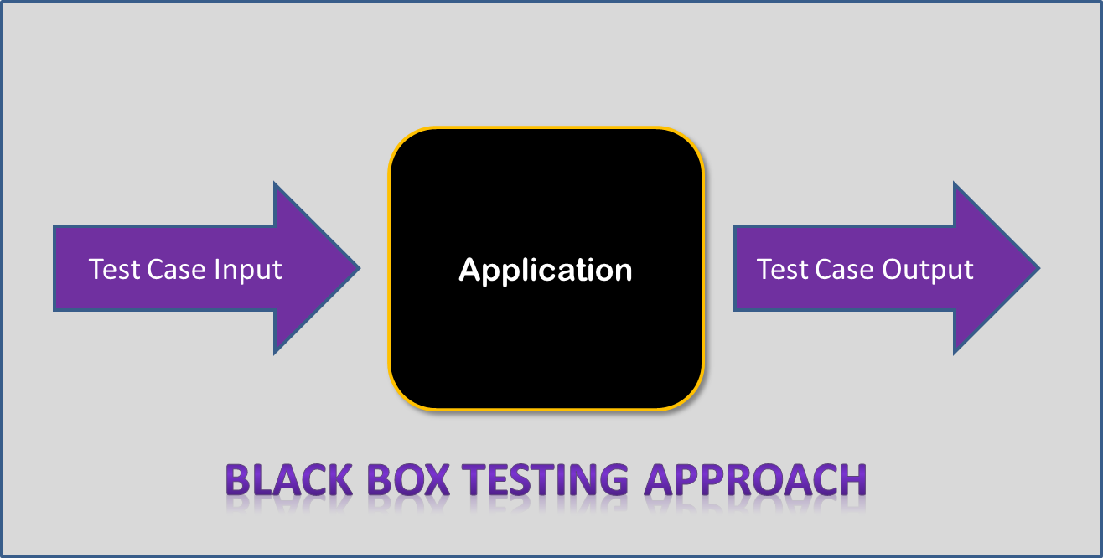
Test Phases: “Black Box” Testing
“Black Box” Testing (Behavioural or Functional Testing):
Most game testing is black box testing;
Testing is conducted from outside application;
No knowledge of or access the source code is granted to tester;
Defects found using same input devices available to the player;
Most cost-effective way to test complex networks of systems and modules that video games represent.

Slide 18
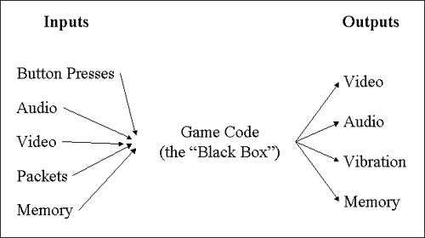
Test Phases: “Black Box” Testing
“Black Box” Testing (Behavioural or Functional Testing):

Slide 19
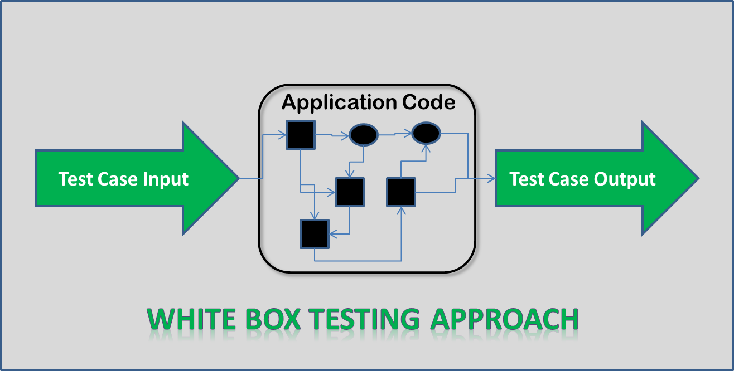
Test Phases: “White Box” Testing
“White Box” Testing (Structural Testing):
Internal structure/design/implementation of game being tested is known to the tester;
Allows tester to exercise source code directly;
Examines program structure deriving test data from program logic/code;
White Box testing examines statement, branch and path coverage;
Test developers focus on the implementation;
Process reveals “hidden” code;
Identifies issues associated with best programming practices.

Slide 20
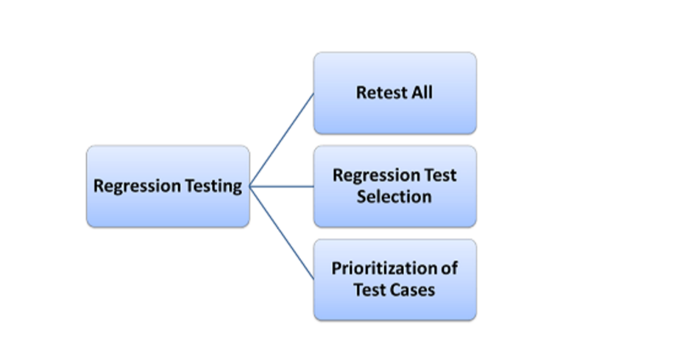
Test Phases: Regression Testing
Regression Testing:
Obtains its name from determining whether any good has “regressed” resulting from changes introduced in latest build;
Aims to identify new or remaining errors in code;
Retest all: all the tests in the existing test suite should re-executed;
Regression Test Selection: part of the test suite to be run is selected;
Prioritisation of Test Cases: increase a test suite’s rate of fault detection; test cases of higher priority are executed before test cases of lower priority.

Slide 21

Today
Ensure your GitHub accounts for project management and version control are created;
Brainstorm and discuss game ideas;
Record and document your thoughts (including ideas you discard);
Why did you discard them? Record that as well;
If possible, agree on the best game idea for your team;
What makes it the best idea?
Commence the outline of your GDD;
Prioritise tasks and plan the development of project over the trimester.

Slide 22
References
Aleem, S., Fernando Capretz, L. and Ahmed, F. (2016). Game development software engineering process life cycle: a systematic review. Journal of Software Engineering Research and Development. Vol. 4, No. 6, pp. 1-30. DOI: 10.1186/s40411-016-0032-7
Fullerton, T. (2014, 3rd ed.). Game Design Workshop: A Playcentric Approach to Creating Innovative Games. CRC Press.
Gibson, J. (2015). Introduction to Game Design, Prototyping, and Development: From Concept to Playable Game – with Unity and C#. Addison-Wesley.
Principles behind the Agile Manifesto. (n.d.) [Online] Available: http://agilemanifesto.org/principles.html [Accessed: 15 July 2017].
Ramadan, R. and Widyani, Y. (2013). Game Development Life Cycle Guidelines. 2013 International Conference on Advanced Computer Science and Information Systems (ICACSIS), 28-29th Sept., IEEE. DOI: 10.1109/ICACSIS.2013.6761558
Schell, J. (2015, 2nd ed.). The Art of Game Design: A Book of Lenses. CRC Press.
Schultz, C.P. and Bryant, R.D. (2017, 3rd ed.). Game Testing: All In One. Mercury Learning and Information.
Stellman, A. and Greene, J. (2015). Learning Agile: Understanding Scrum, XP, Lean, and Kanban. O’Reilly Media, Inc.

